Slide 1

cv
IoT-powered technologies and Machine Learning based Driver Drowsiness Detection system .
Team Members
ANAPOORNA 1DS20CS401
2. BAPU D PUNEETH KUMAR 1DS20CS403
3. DIVYA M 1DS20CS408
4. THEJESH KUMAR H MUTT S 1DS20CS423
Under the Guidance of
Mrs. Sunanda
Assistant Professor, Dept of Computer Science and Engineering
Department of Computer Science & Engineering, DSCE

Slide 2
cv
Introduction
Road accidents are one of the leading causes of fatal accidents indiscriminate of roadway and time. This is intensified by the increase in the number of vehicles around the world.
According to a research conducted by the Central Road Research Institute (CRRI) on the 300-km Agra-Lucknow Expressway, sleepy or fatigued drivers cause 40% of traffic accidents.
Fatigue can easily set in during long journeys, particularly when drivers take inadequate rest periods or pause to help break up the monotony.
The proposed system contributes to preventing fatal accidents due to driver drowsiness or fatigue. Although it is not possible to control sleepiness, it is possible to detect it and alert the driver using
An alarm/buzzer which will prevent the risk of fatal accidents.
Department of Computer Science & Engineering, DSCE

Slide 3
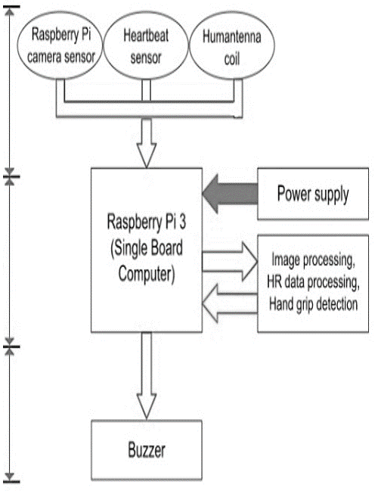
cv
System Design
The system is designed on a combined method approach and has three layers as shown in the figure.
Fig. 2.1: System design
As depicted the raw data from input components is fed to the Raspberry Pi 3 board for data analysis and processing. To analyze and process data means to identify the features of data and process them to identify drowsiness in drivers.
Department of Computer Science & Engineering, DSCE

Slide 4
cv
Methodology
There are three stages in the proposed system as follows:
A. Data collection
• Image acquisition
• Heartbeat rate
• Touch sensing
B. Data processing
Once the data is collected it is processed using the Raspberry Pi 3 interface. The raw data obtained by the sensors must be analyzed for Region of Interest(RoI), threshold comparision and must be processed for drowsiness detection.
C. Alert
A buzzer is used to alert the driver if drowsiness is identified by data processing.
Department of Computer Science & Engineering, DSCE

Slide 5
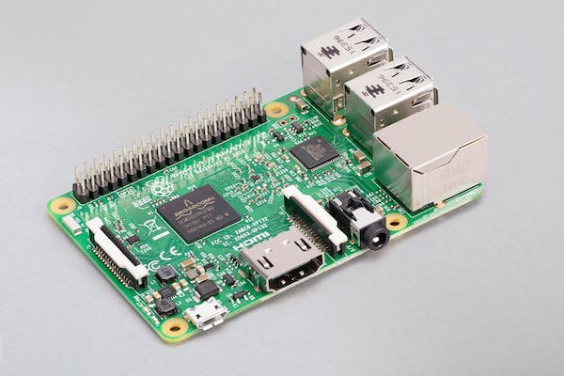
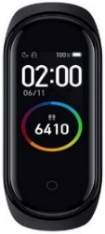

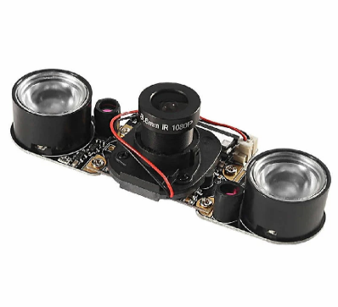
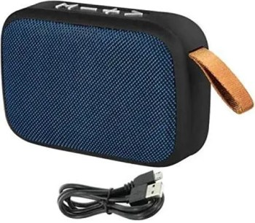
cv
Components
Processing
Input
Output
Department of Computer Science & Engineering, DSCE

Slide 6
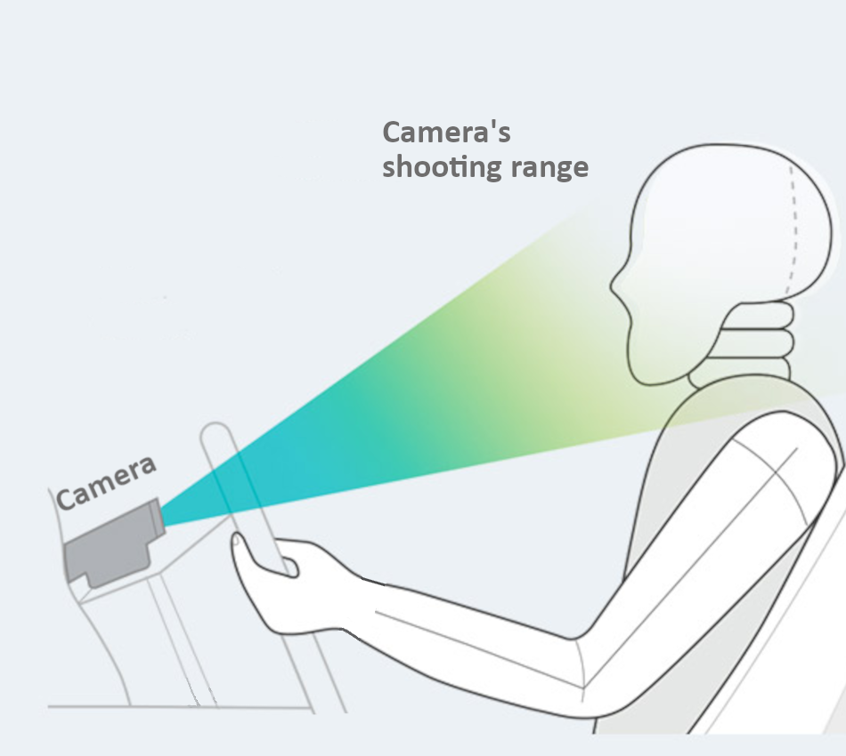
cv
Camera sensor
Haar Cascade algorithm
Dlib’s facial landmarks
Eye Aspect Ratio
Department of Computer Science & Engineering, DSCE

Slide 7
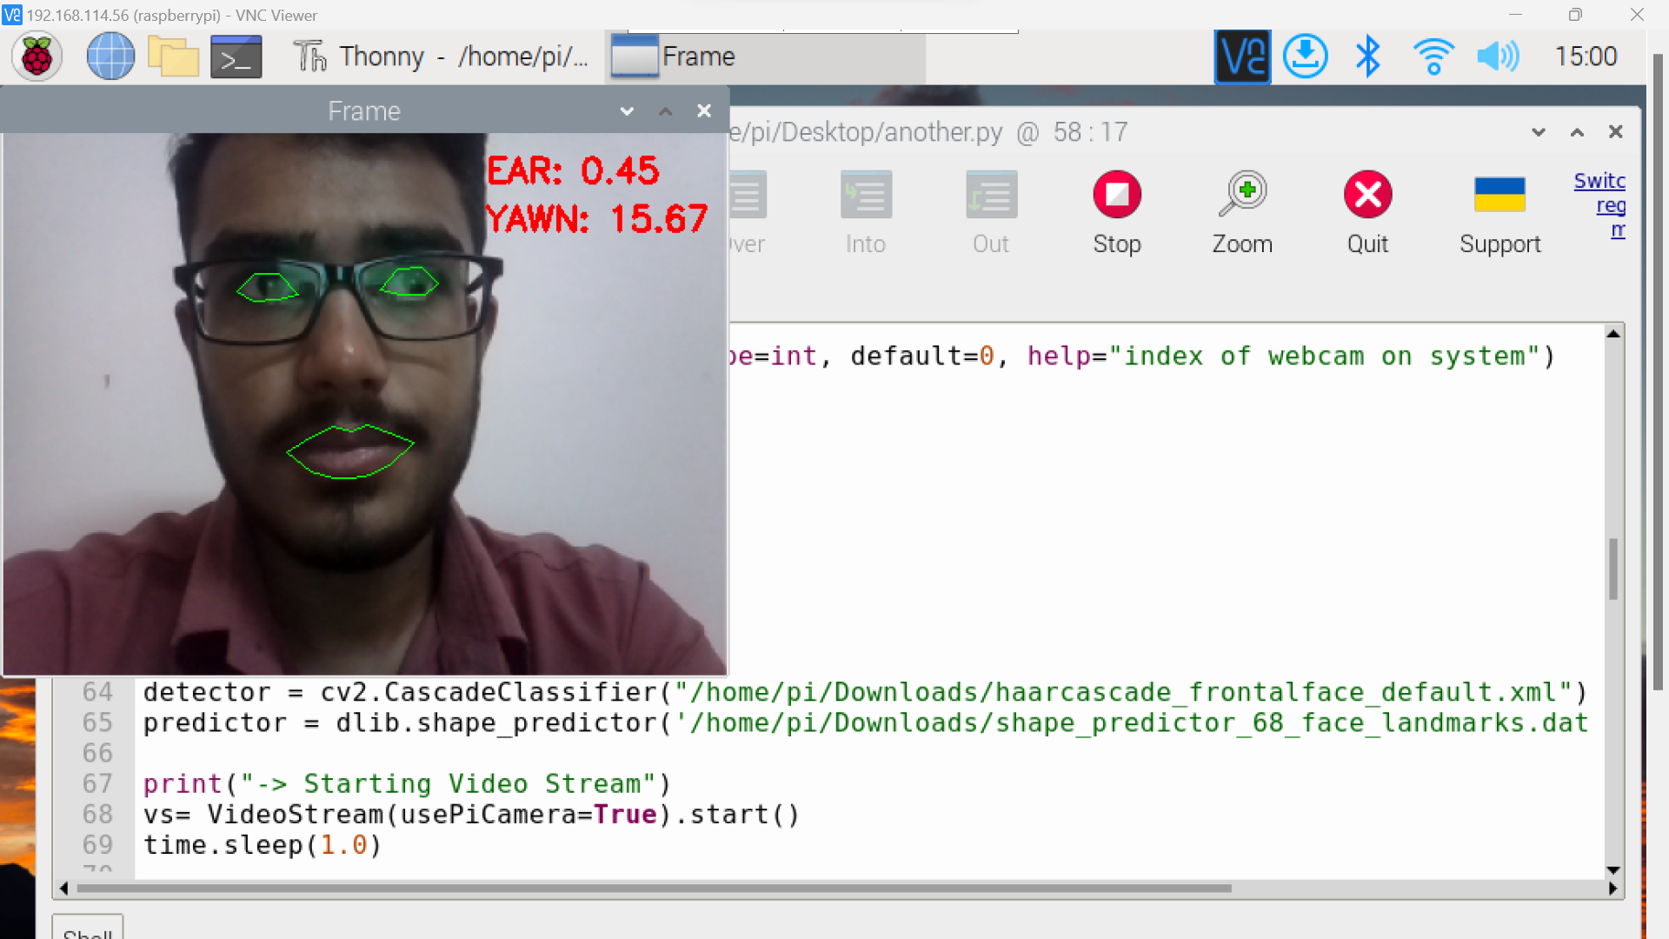
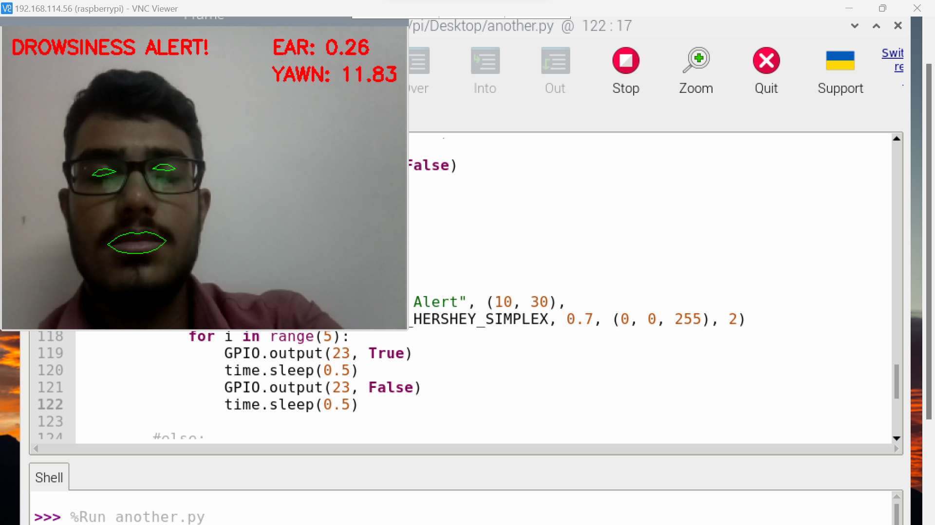
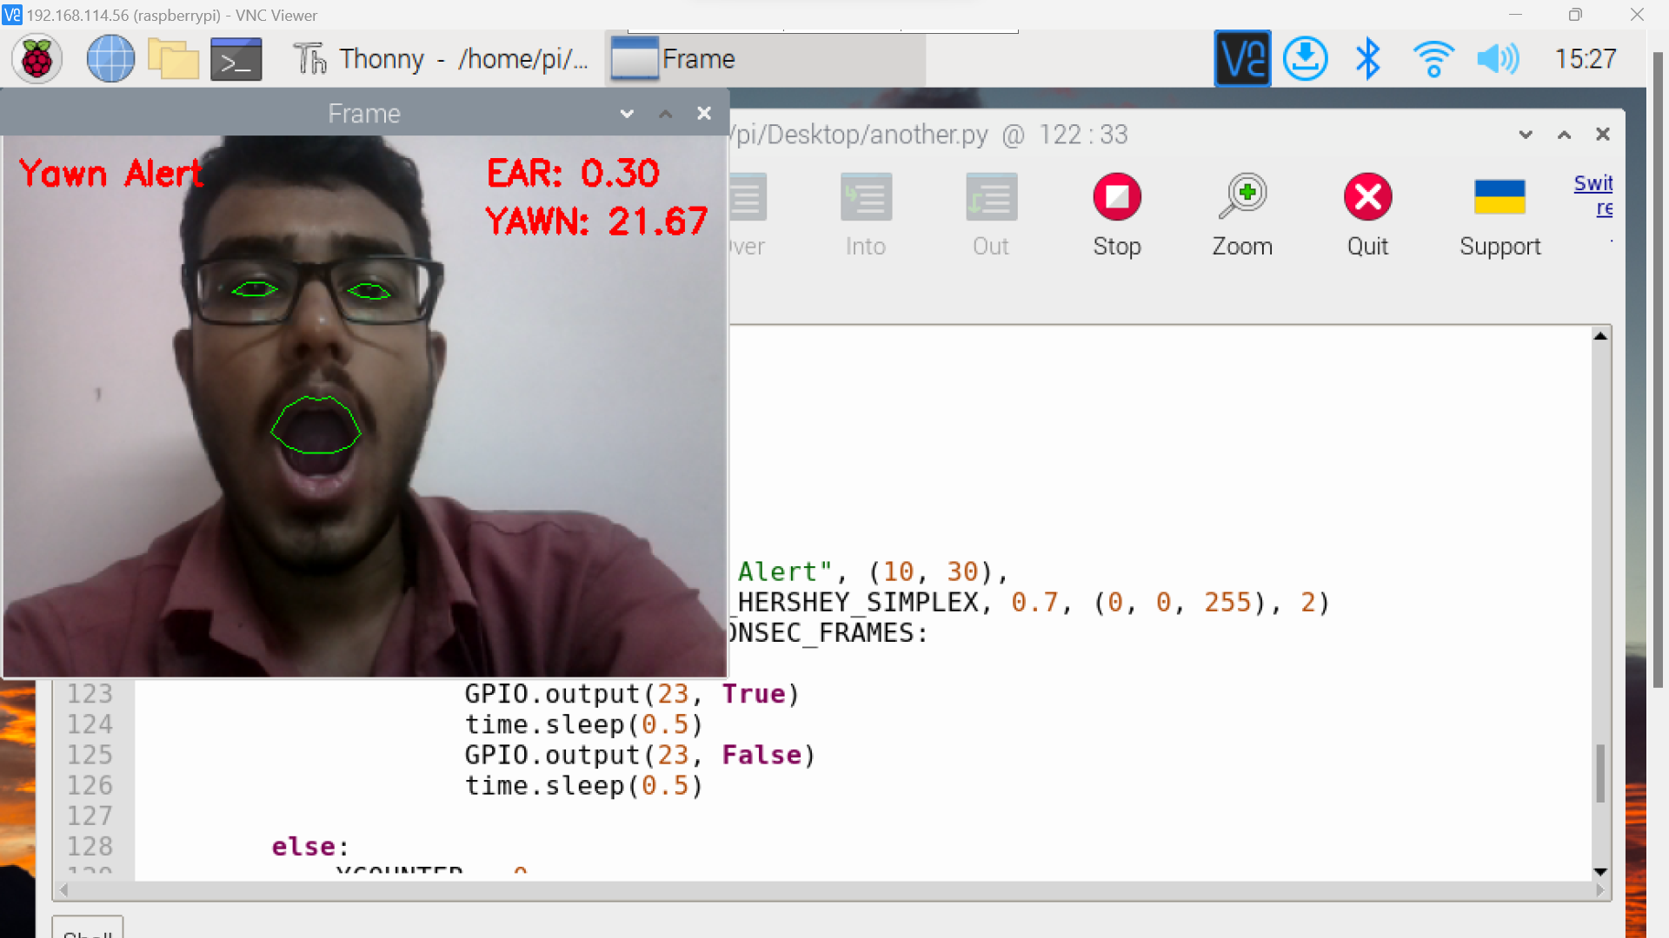
cv
Camera sensor
Normal State
Drowsy state: Eye closure
Drowsy state: Yawn detection
Department of Computer Science & Engineering, DSCE

Slide 8
cv
Camera sensor
Night vision
Department of Computer Science & Engineering, DSCE

Slide 9
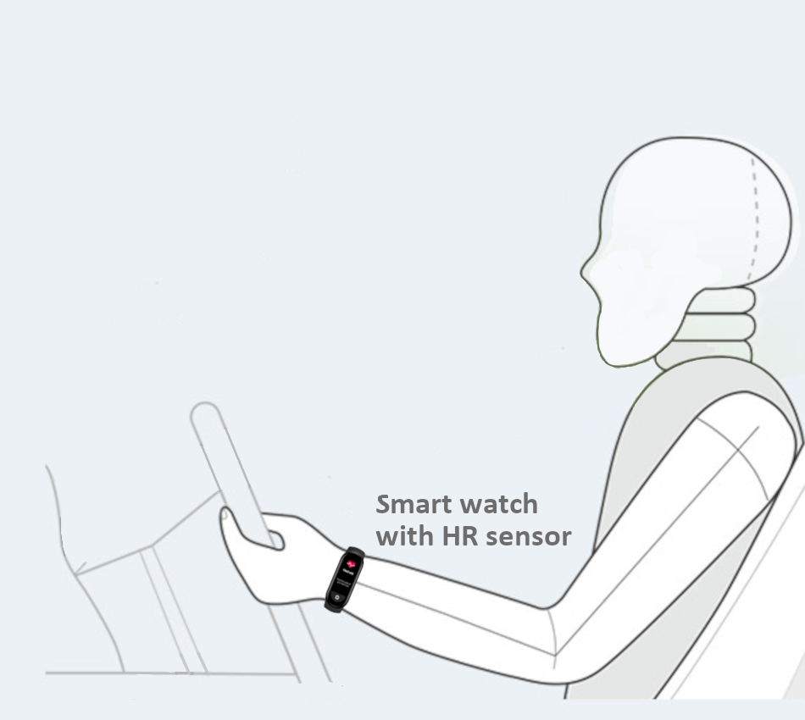
cv
Heart-rate sensor
Heart rate sensor embedded smart watch or a heart rate sensor
Department of Computer Science & Engineering, DSCE

Slide 10
cv
Heart-rate sensor
Department of Computer Science & Engineering, DSCE

Slide 11
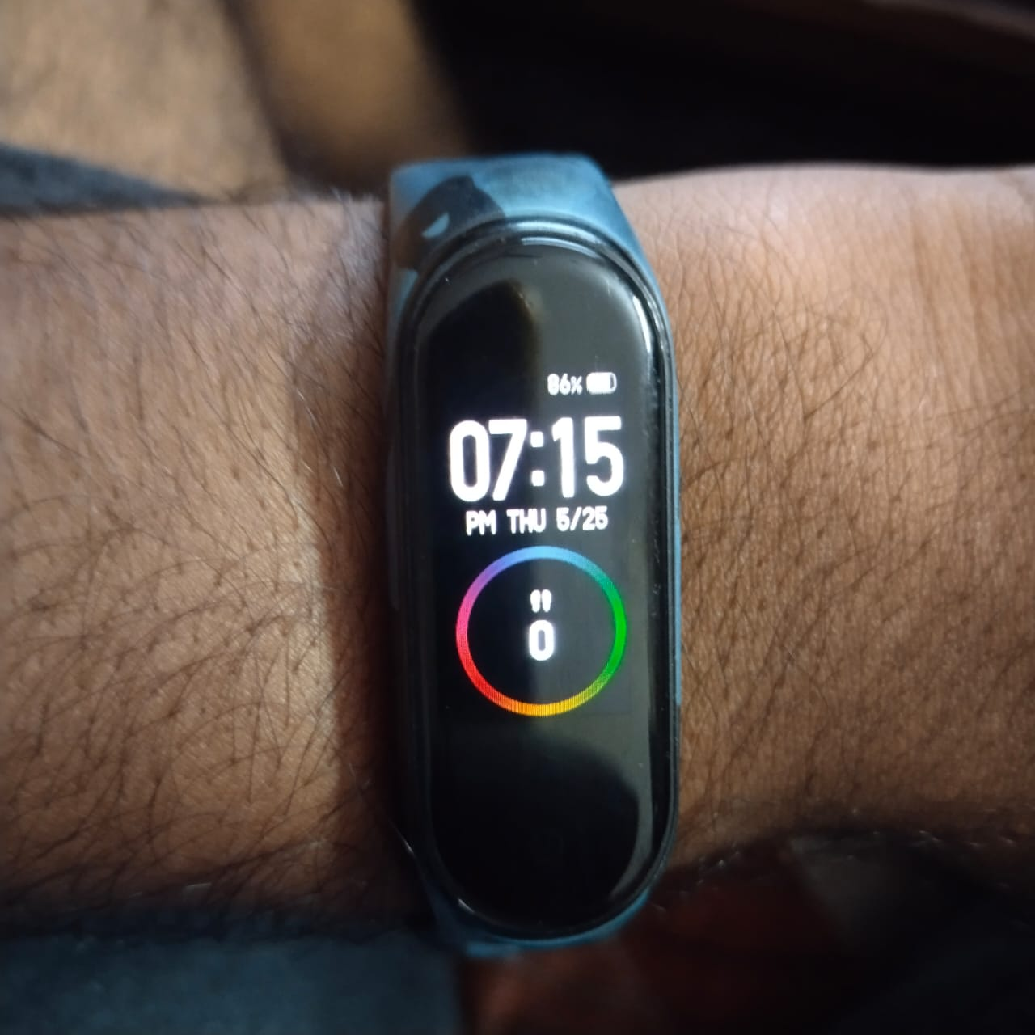
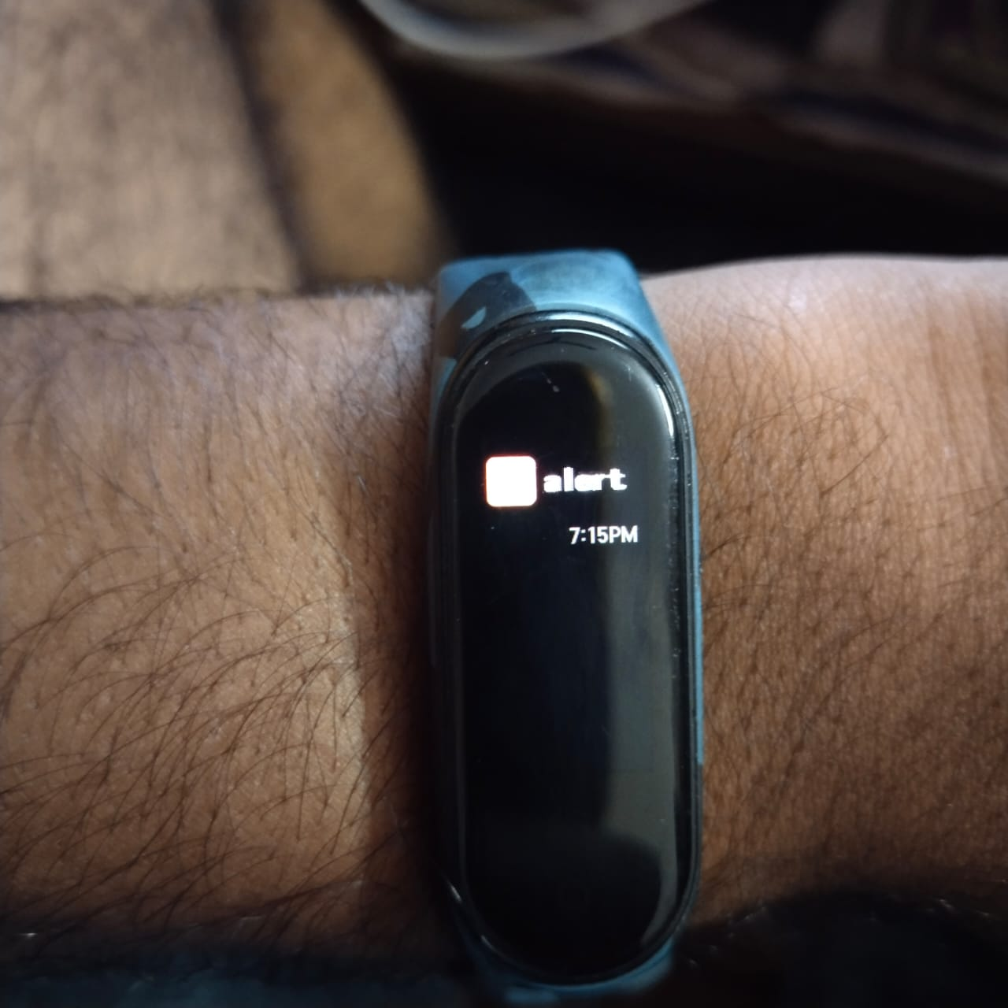
cv
Heart-rate sensor
Drowsy Alert
Mi Band 4
Department of Computer Science & Engineering, DSCE

Slide 12
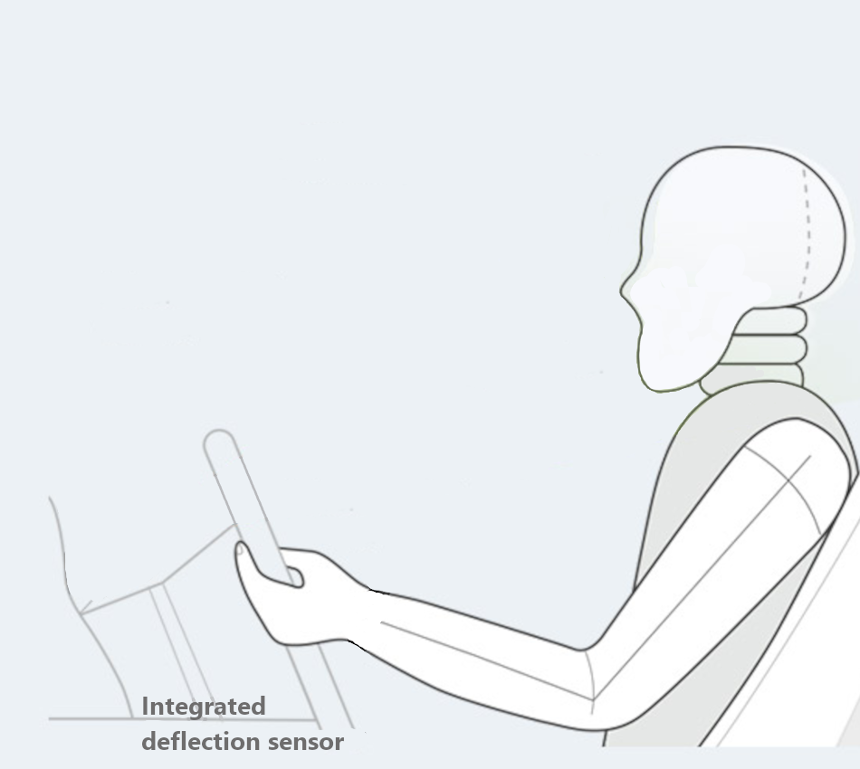
cv
Velostat pressure sensor
Velostat sensor
Woven Conductive sheet
Hum-antenna technique
Department of Computer Science & Engineering, DSCE

Slide 13
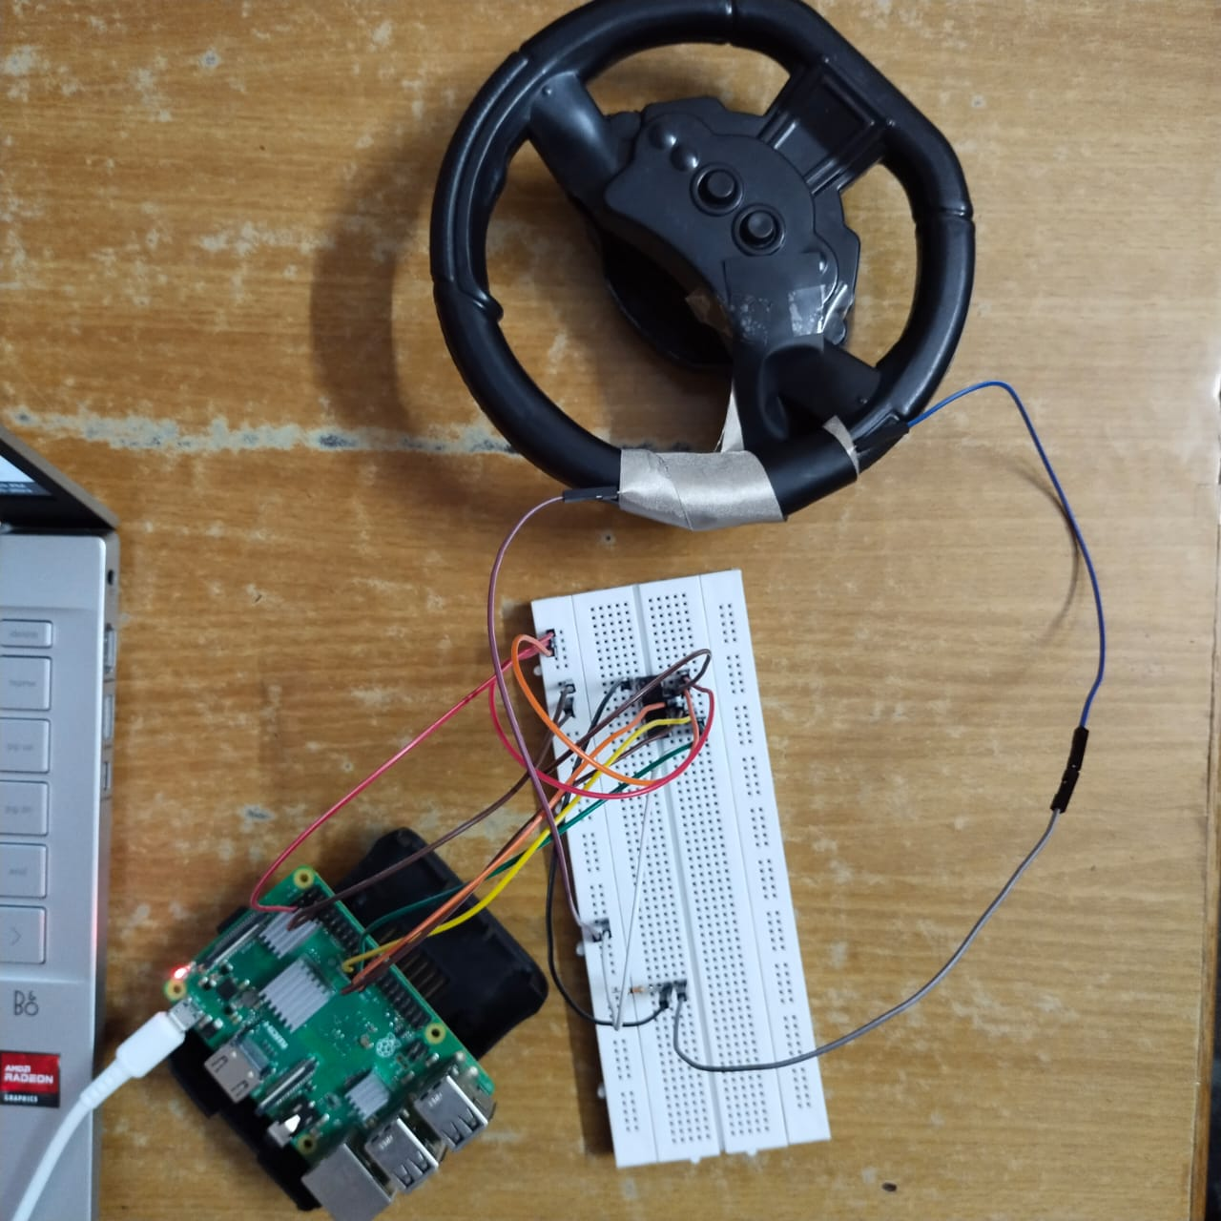
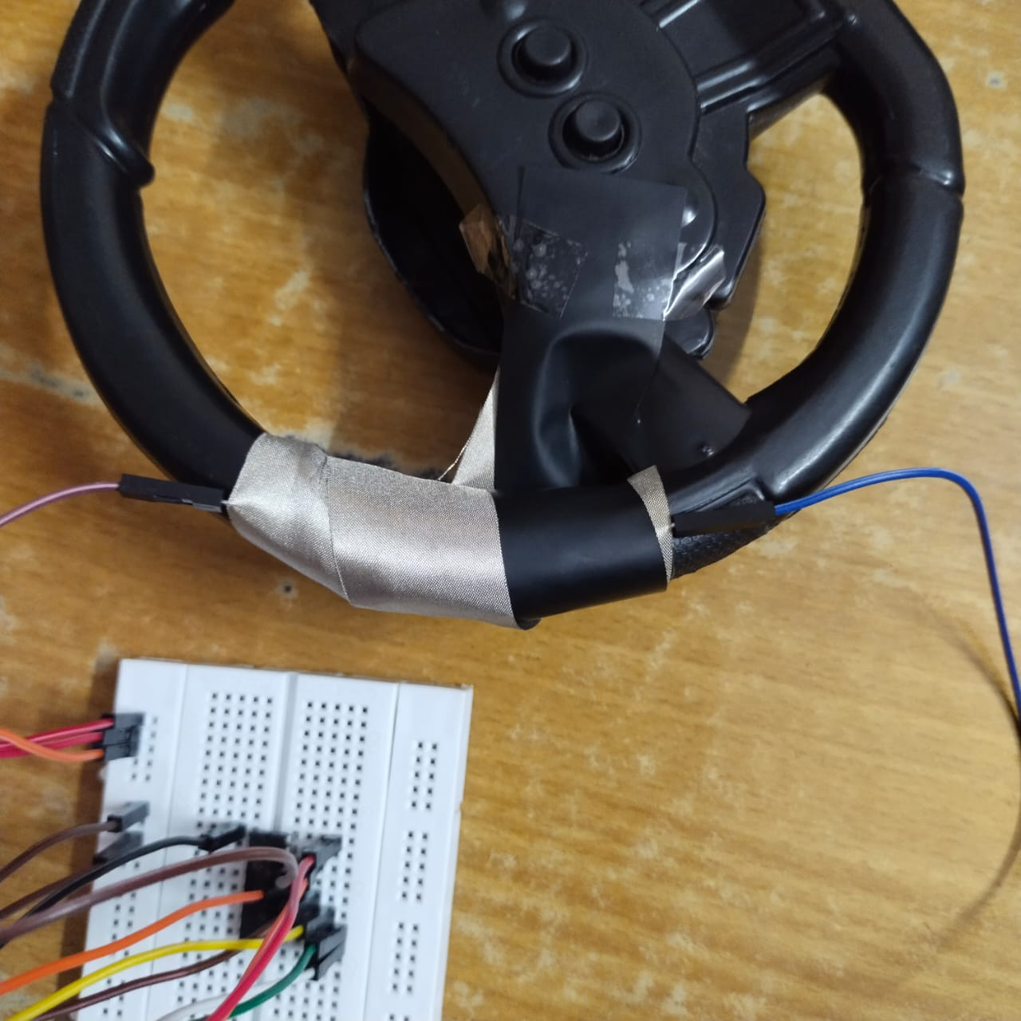
cv
Velostat pressure sensor
Velostat pressure sensor setup
Department of Computer Science & Engineering, DSCE

Slide 14
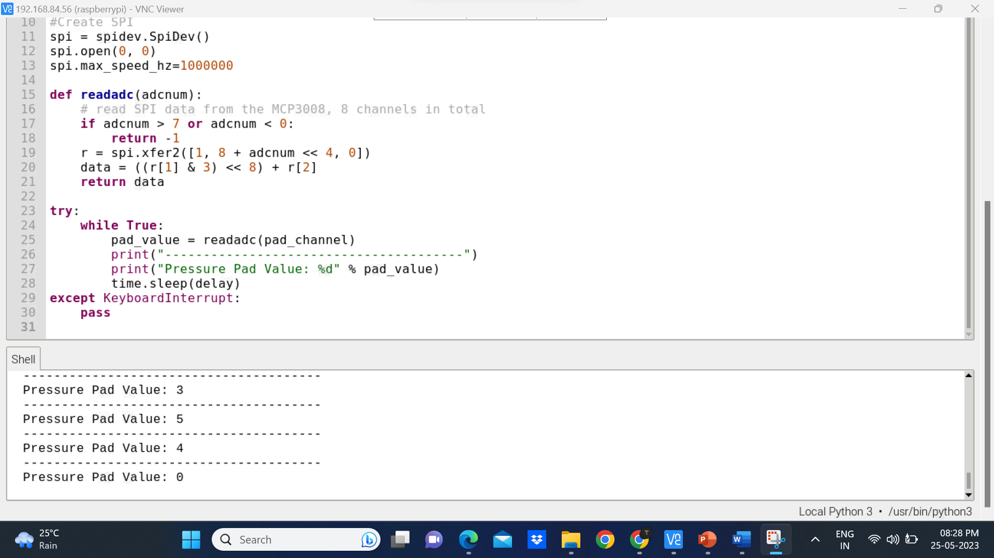
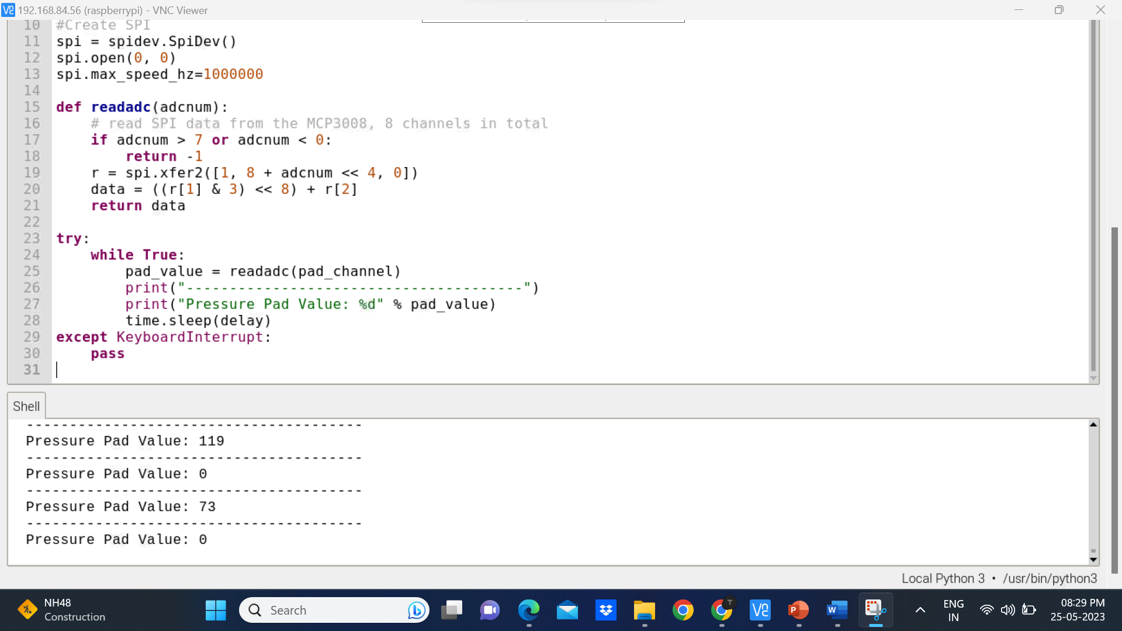
cv
Velostat pressure sensor
Department of Computer Science & Engineering, DSCE

Slide 15
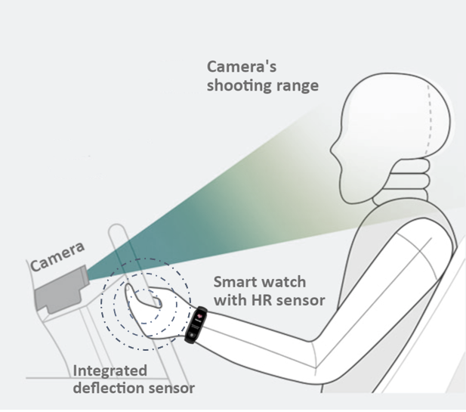
cv
Combined system
Department of Computer Science & Engineering, DSCE

Slide 16
cv
Conclusion
The real-time video stream from raspberry pi night vision camera is used to detect driver drowsy while driving in long distance, the system is successful in classifying blinking from sleeping and it works fine in both Day and Night times.
Touch sensor are called as tactile sensors and are sensitive to touch, force or pressure.it can be implemented on steering while the driver losses the hand grip the buzzer get ring to alert driver.
This project is based on multiple-approach integration technique for driver drowsiness detection i.e., camera module, smart watch and pressure-sensitive conductive sheet.
The alert is given by vibrator incorporated in the mi band 4 which will be activated in case of drowsiness detection, Bluetooth speaker is used to provide a voice alert with the specific aspect where drowsiness is detected and a third-party messaging site is used to send an alert message to emergency contact.
Department of Computer Science & Engineering, DSCE

Slide 17
cv
Scope for future work
The increase in the population of vehicles all over the world acts as a fuel for the proposed system.
The system uses major approach such as facial analysis, heart rate analysis, and steering grip analysis for drowsiness detection. This can be considered as crucial aspects through which drowsiness can be detected. Although some other aspects like vehicular based techniques: (1) Driving Lane technique: In which the vehicle driving lane is analyzed for any faulty driving through which driver drowsiness can be predicted, (2) Steering wheel technique: In which the steering wheel handling is analyzed for any sudden pull or faulty handling of the steering through which driver drowsiness is predicted.
The system is successful in classifying blinking from sleeping by providing frame length to ignore blinking. The system detects drowsiness when the yawn threshold is met however it does not classify talking from yawning which can be implemented using audio detection which can be used to classify talking from capturing real-time audio.
Department of Computer Science & Engineering, DSCE

Slide 18
cv
THANK YOU
Department of Computer Science & Engineering, DSCE

